Slide 1
Ice-Breakers
Finding Differences

Slide 2
Lady at desk
Find 6 differences between cartoons

Slide 3
Bottom of chair is different.

Slide 4
2. On right, paper in her hand is larger.

Slide 5
3. On right, 3 pieces of paper on desk.

Slide 6
4. Ladies’ hair is different.

Slide 7
5. On right, lamp is smaller.

Slide 8
6. Window is different.

Slide 9
#2 Cutting grass
Find 6 differences between cartoons

Slide 10
#2 Cutting grass
1. Boy’s leg is moved.

Slide 11
#2 Cutting grass
2. On right, a golf club is missing.

Slide 12
#2 Cutting grass
3. On right, tree trunk is thicker

Slide 13
#2 Cutting grass
4. On right, boy’s shirt is shorter.

Slide 14
#2 Cutting grass
5. Golfer’s fingers are different.

Slide 15
#2 Cutting grass
6. Boy’s hair is different.

Slide 16
#3 Men golfing
Find 6 differences between cartoons

Slide 17
#3 Men golfing
On right, a golf club is missing.

Slide 18
#3 Men golfing
2. On right, man’s arm not showing.

Slide 19
#3 Men golfing
3. On right, driver’s glove is missing.

Slide 20
#3 Men golfing
4. On right, the path is narrower.

Slide 21
#3 Men golfing
5. Golfer’s shoes are different.

Slide 22
#3 Men golfing
6. On right, the tree has more leaves.

Slide 23
#4 Boy and Girl
Find 6 differences between cartoons

Slide 24
#4 Boy and Girl
On right, the scooter is longer.

Slide 25
#4 Boy and Girl
2. Girl’s leg is different.

Slide 26
#4 Boy and Girl
3. On right, the door handle is lower.

Slide 27
#4 Boy and Girl
4. On right, boy’s collar is different.

Slide 28
#4 Boy and Girl
5. On right, bow on girl’s hair missing.

Slide 29
#4 Boy and Girl
6. On right, girl’s sock is missing.

Slide 30
#5 Father and son
Find 6 differences between cartoons

Slide 31
#5 Father and son
On right, a ladder rung is missing.

Slide 32
#5 Father and son
2. On right, picture on shirt is lower.

Slide 33
#5 Father and son
3. On right, perch on birdhouse is shorter.

Slide 34
#5 Father and son
4. On right, birdhouse is lower.

Slide 35
#5 Father and son
5. On right, boy’s freckles are missing.

Slide 36
#5 Father and son
6. On right, roof is smaller.

Slide 37
#6 Raining outside
Find 6 differences between cartoons

Slide 38
#6 Raining outside
On right, a golf club is missing.

Slide 39
#6 Raining outside
2. On right, the lady’s sleeve is
shorter.

Slide 40
#6 Raining outside
On right, outside puddle is missing.

Slide 41
#6 Raining outside
4. On right, the man is thinner.

Slide 42
#6 Raining outside
5. The picture on wall is different.

Slide 43
#6 Raining outside
On right, the broom bristles
are longer.

Slide 44
At the Doctor’s
Find 6 differences between cartoons

Slide 45
At the Doctor’s
On right, doctor’s watch missing.

Slide 46
At the Doctor’s
2. On right, man’s tie is longer.

Slide 47
At the Doctor’s
3. On right, the lamp is smaller.

Slide 48
At the Doctor’s
4. The cactus is different.

Slide 49
At the Doctor’s
5. The window is different.

Slide 50
At the Doctor’s
6. 1 Diploma on wall is different

Slide 51
Man with flowers
Find 6 differences between cartoons

Slide 52
Man with flowers
On right, a flower is missing.

Slide 53
Man with flowers
2. On right, man’s jacket is shorter.

Slide 54
Man with flowers
3. On right, man’s bow tie is missing.

Slide 55
Man with flowers
4. On right, man’s mouth is open.

Slide 56
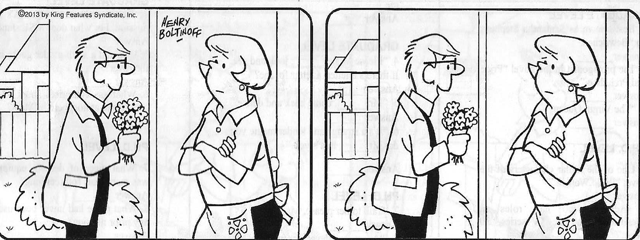
Man with flowers
5. On right, doorknob is missing.

Slide 57
Man with flowers
6. Roof is different.

Slide 58
Boy selling cookies
Find 6 differences between cartoons

Slide 59
Boy selling cookies
On right, lady’s sleeve is different.

Slide 60
Boy selling cookies
2. Box in boy’s hand is different.

Slide 61
Boy selling cookies
3. Boy’s sneakers are different.

Slide 62
Boy selling cookies
4. On car, back bumper is missing.

Slide 63
Boy selling cookies
5. On right, lady’s socks are different.

Slide 64
Boy selling cookies
6. Boy’s mouth is different.

Slide 65
THE END
Credit: Sarasota Herald Tribune, January 2018

